Slide 1
COUNTABLE AND UNCOUNTABLE NOUNS

Slide 2
COUNTABLE NOUN
Nouns that can be counted are called countable nouns.

Slide 3
COUNTABLE NOUN
Nouns that can be counted are called countable nouns.
Eg
dog
bag
building
table
ant

Slide 4
Common and collective nouns are countable nouns.

Slide 5
Points to remember

Slide 6
Countable nouns have plural forms.

Slide 7
Words like a, an are used with singular countable nouns

Slide 8
We use numbers (one, two) with countable nouns.

Slide 9
UNCOUNTABLE NOUN
Nouns that cannot be counted are called uncountable nouns.

Slide 10
UNCOUNTABLE NOUN
Nouns that cannot be counted are called uncountable nouns.
Eg:
dust
smoke
gold
water

Slide 16
Uncountable nouns do not have plural forms.
We can’t use a, an or a number before an uncountable noun

Slide 17
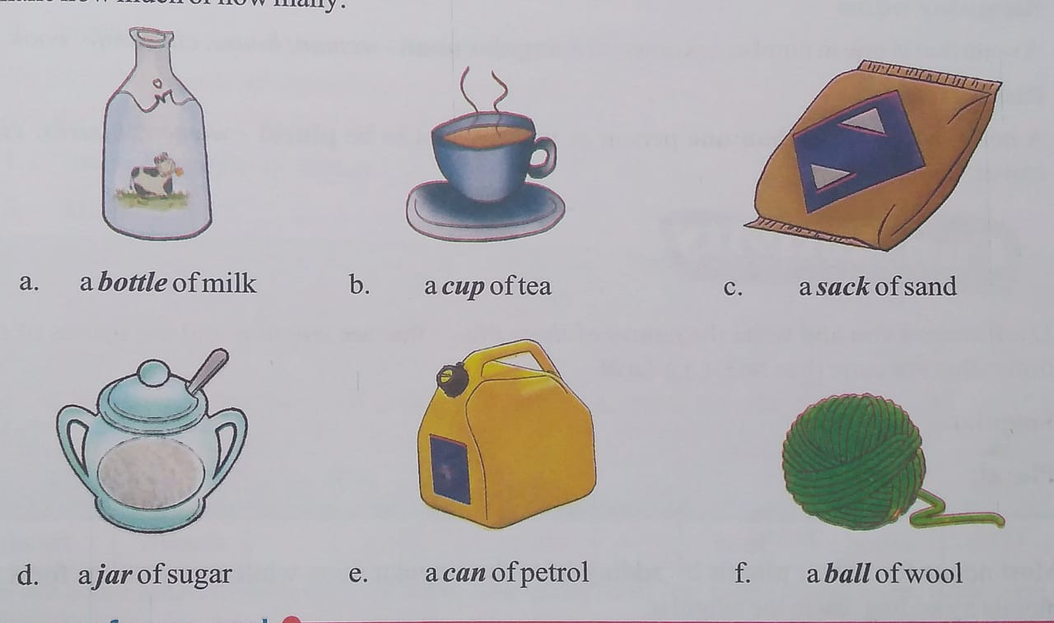

Slide 18
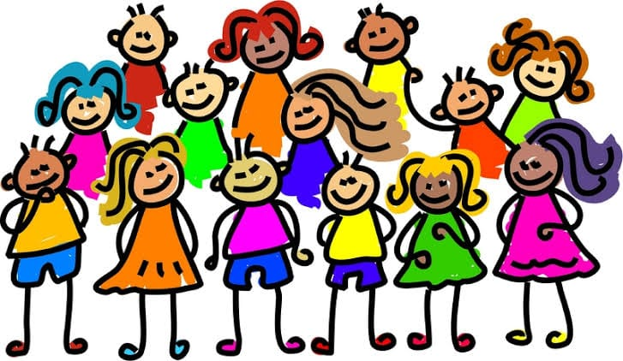
COUNTABLE UNCOUNTABLE NOUN NOUN
MANY
MUCH
I have many friends.
I have eaten too much food.

Slide 19
COUNTABLE UNCOUNTABLE NOUN NOUN
a few
a little
Add a little milk.
I have a few pens.

Slide 20
THANK YOU

